Slide 1

ME150 Materials Science and Engineering I
Üniversiteye, Memlekete Özgürlük!
Department of Mechanical Engineering
2026 Spring Term, 3 Credits
Prof. Dr. Sinan Kandemir
Time:
Monday 13.30-15.15, Friday 14.30-15.15
Location: A01
MS Teams Code: ykm624l

Slide 2
Üniversiteye, Memlekete Özgürlük!
INSTRUCTORS:
Sinan Kandemir
Room: Z16
E-mail: sinankandemir@iyte.edu.tr
Office hours: Monday 09.45-10.30
Teaching Assistants:
Büşra İrem Türkpençesi
Mehmet Yalçın Sırmalılar
Samedhan Yıldırım

Slide 3
Üniversiteye, Memlekete Özgürlük!
COURSE MATERIAL:
Lectures
Required text book
Materials Science and Engineering: An Introduction,
William D. Callister and David G. Rethwisch, John
Wiley and Sons Inc., It does not matter which edition
you have!
Website: http://www.wileyplus.com/college/callister
Student Companion Site
Users can manipulate molecules and crystals to better visualize atomic structure, Unit cells such as
BCC, FCC, HCP, Crystallographic planes, directions,
and defects, Polymer repeat units and molecules,
Diffusion computations

Slide 4

Üniversiteye, Memlekete Özgürlük!
OPTIONAL MATERIAL:
Schaffer, J. P., Saxena, A., Antolovich, S. D., Senders, Jr., T. H. and Warner, S. B., “The Science and Design of Engineering Materials” R. D. Irwın, Inc.
Shackelford, J. F. “Introduction to Materials Science for Engineers” Macmillan Publishing Inc.

Slide 5
Üniversiteye, Memlekete Özgürlük!
Why do you need a lecturer if you have a book & HW assignments?
To explain the most difficult concepts of the chapter during the lectures
To provide you additional materials, which you cannot find in the book, but which could be very useful in your future research (please take notes)
To discuss and address any kind of questions and concerns on the course (during lectures, TA and office hours)
To use his/her experience in material science for any kind of consultations, which may be related to your current projects
To fairly grade your HW, Quizzes, Exams and etc., providing you the opportunity to get high final marks!!
https://www3.nd.edu/~amoukasi/CBE30361/Lecture_1_2014_lecture.pdf

Slide 6
Üniversiteye, Memlekete Özgürlük!
Suggestion for success in this lecture
Attendance is your job – come to class!
Read the relevant material in the book (preferably before the lecture!)
Review and understand the examples given in the book and/or website.
Do the assigned homework. If you are having difficulty with a particular concept, work additional problems given in the book and/or website on that topic that have the answers given in the back of the book.
Come to office and TA’s hours
Any suggestion/opinion/request are welcome
Academic success is directly proportional to the amount of time devoted to study!!
https://www3.nd.edu/~amoukasi/CBE30361/Lecture_1_2014_lecture.pdf

Slide 7
Üniversiteye, Memlekete Özgürlük!
ASSESSMENT:
Midterm: 35%
Quiz: 20%
Final exam: 45%
(Weighting may be slightly modified)
Exams will be based on homework and information provided in lectures and assigned readings. All exams will be closed book. The final will be cumulative. Relevant formulas, tables, etc. will be provided.
Please do not come to the office to ask additional points, etc.
Quizzes will be scheduled.
70% Attendance is required.
Final Exam score has to be higher than 40.

Slide 8
Üniversiteye, Memlekete Özgürlük!
Several important issues
You should have a complete (100%) understanding of all concepts that I am talking about!!!
You should understand why this course is important!
Essentials
To share knowledge with passion
To be ready to help and support young engineers
To support creativity and willingness to learn
A high final grade for the student is my main goal
Let’s start

Slide 9
Üniversiteye, Memlekete Özgürlük!
Course Objective...
Introduce fundamental concepts in Materials
Science
You will learn about:
• material structure
• how structure dictates properties
• how processing can change structure
This course will help you to:
• use materials properly
• realize new design opportunities
with materials

Slide 10
Üniversiteye, Memlekete Özgürlük!
1. Introduction
What is materials science?
Multidisciplinary field of science devoted to understanding and manipulating the different materials properties including physical, mechanical, electrical, etc. It investigates relationships that exist between the structure and properties of materials.
Materials Engineering is on the basis of these structure-property correlations, designing or engineering the structure of a material to produce a pre-determined set of properties

Slide 11
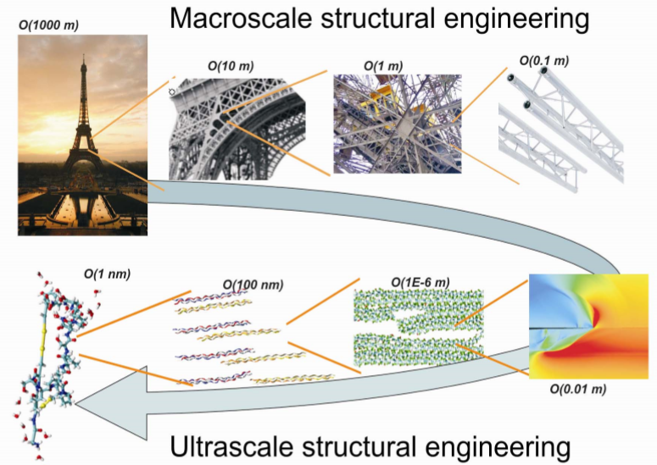
Üniversiteye, Memlekete Özgürlük!
Buehler and Ackbarow, Materials Today, 2007

Slide 12
Üniversiteye, Memlekete Özgürlük!
Why should we know about it
Mechanical engineering is among the most diversified of the traditional engineering disciplines. Mechanical engineers design and build machines and devices that enable humans to live and work in space, in the air, on the ground, and under water.
Naturally, much of what engineers can or cannot do depends on the materials they have available to tackle their tasks. This is why engineers and material scientists work closely together with the goal of tailoring not only the mechanical, but also chemical and electrical properties of materials to make new applications possible.
We have to be able to talk with materials scientist on the same professional language, formulate the problem and outline routes for it solution.

Slide 13
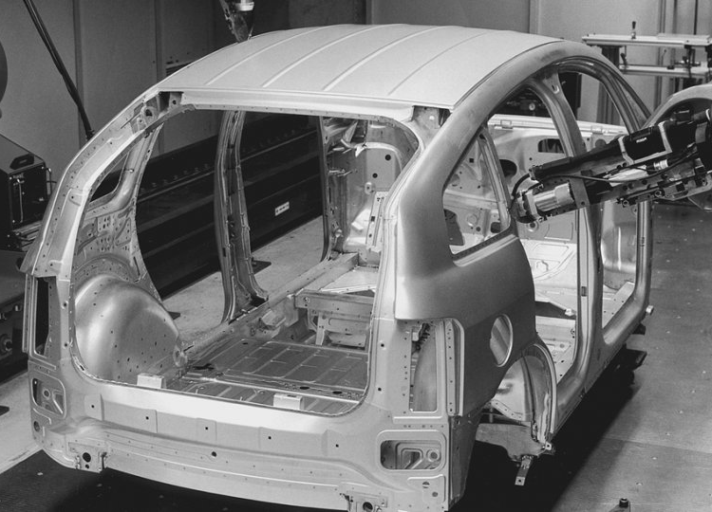
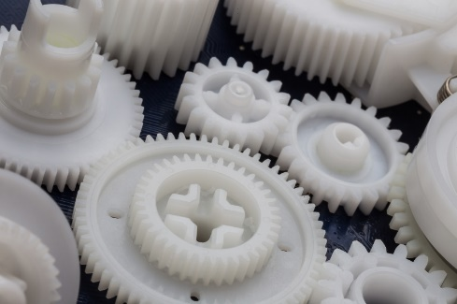
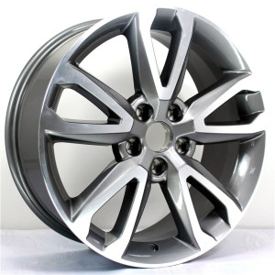
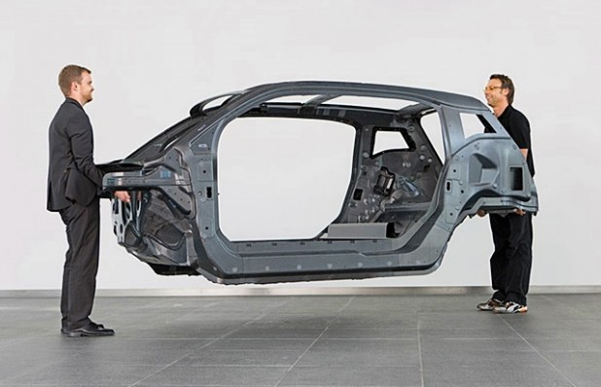
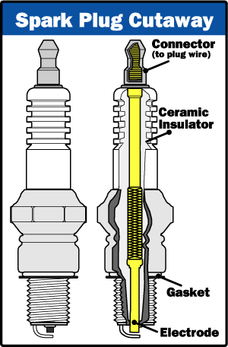
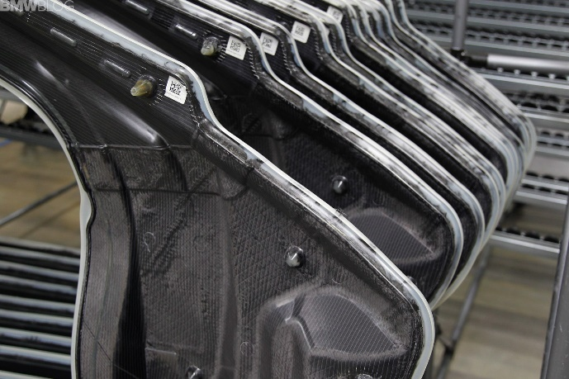
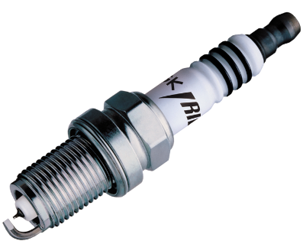
Üniversiteye, Memlekete Özgürlük!

Slide 14
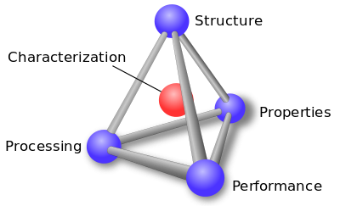
Üniversiteye, Memlekete Özgürlük!
Understanding Materials
Processing → Structure → Properties → Performance
Material properties depend on the material micro/nano structure, which in turn, results from its composition and processing
Optimization
Tetrahedron of Materials Science and Engineering

Slide 15
ELECTRICAL
Üniversiteye, Memlekete Özgürlük!
• Electrical Resistivity of Copper:
6
Adapted from Fig. 18.8, Callister & Rethwisch 8e. (Fig. 18.8 adapted from: J.O. Linde, Ann Physik 5, 219 (1932); and C.A. Wert and R.M. Thomson, Physics of Solids, 2nd edition, McGraw-Hill Company, New York, 1970.)
5
Cu + 3.32 at%Ni
4
Cu + 2.16 at%Ni
Resistivity, ρ
deformed Cu + 1.12 at%Ni
3
(10⁻⁸ Ohm-m)
2
Cu + 1.12 at%Ni
1
“Pure” Cu
0
-200
-100
0
T (ºC)
• Adding “impurity” atoms to Cu increases resistivity.
• Deforming Cu increases resistivity.

Slide 16

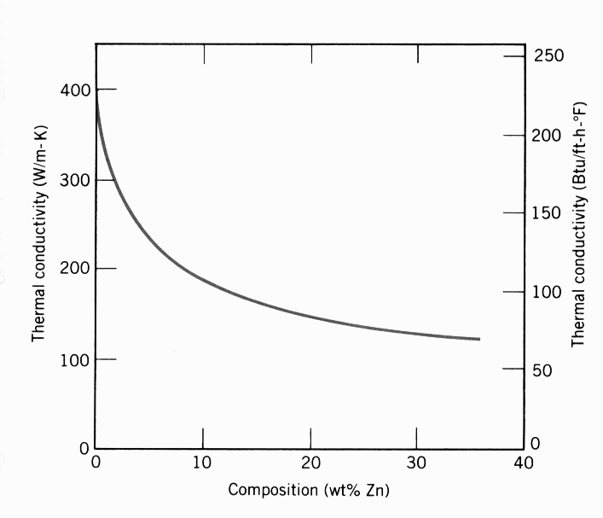
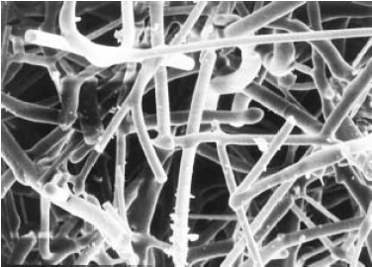
THERMAL
Üniversiteye, Memlekete Özgürlük!
• Space Shuttle Tiles:
-- Silica fiber insulation
offers low heat conduction.
• Thermal Conductivity
of Copper:
-- It decreases when
you add zinc!
Adapted from chapter-opening photograph, Chapter 17, Callister & Rethwisch 3e. (Courtesy of Lockheed
Missiles and Space
Company, Inc.)
400
300
(W/m-K)
Thermal Conductivity
200
100
0
0
10
20
30
40
Composition (wt% Zinc)
Adapted from
Fig. 19.4W, Callister 6e. (Courtesy of Lockheed Aerospace Ceramics Systems, Sunnyvale, CA)
(Note: "W" denotes fig. is on CD-ROM.)
Adapted from Fig. 19.4, Callister & Rethwisch 8e. (Fig. 19.4 is adapted from Metals Handbook: Properties and Selection: Nonferrous alloys and Pure Metals, Vol. 2, 9th ed., H. Baker, (Managing Editor), American Society for Metals, 1979, p. 315.)
100 μm

Slide 17
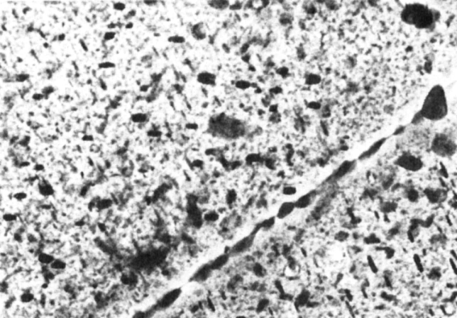
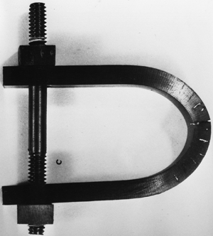

DETERIORATIVE
Üniversiteye, Memlekete Özgürlük!
• Stress & Saltwater...
-- causes cracks!
• Heat treatment: slows
crack speed in salt water!
10
-8
“as-is”
“held at
160ºC for 1 hr
crack speed (m/s)
before testing”
10
-10
Alloy 7178 tested in
saturated aqueous NaCl
solution at 23ºC
increasing load
Adapted from Fig. 11.20(b), R.W. Hertzberg, "Deformation and Fracture Mechanics of Engineering Materials" (4th ed.), p. 505, John Wiley and Sons, 1996. (Original source: Markus O. Speidel, Brown Boveri Co.)
Adapted from chapter-opening photograph, Chapter 16, Callister & Rethwisch 3e.
(from Marine Corrosion, Causes, and Prevention, John Wiley and Sons, Inc., 1975.)
-- material:
7150-T651 Al "alloy"
(Zn,Cu,Mg,Zr)
4 μm
Adapted from Fig. 11.26, Callister & Rethwisch 8e. (Provided courtesy of G.H. Narayanan and A.G. Miller, Boeing Commercial Airplane Company.)

Slide 18
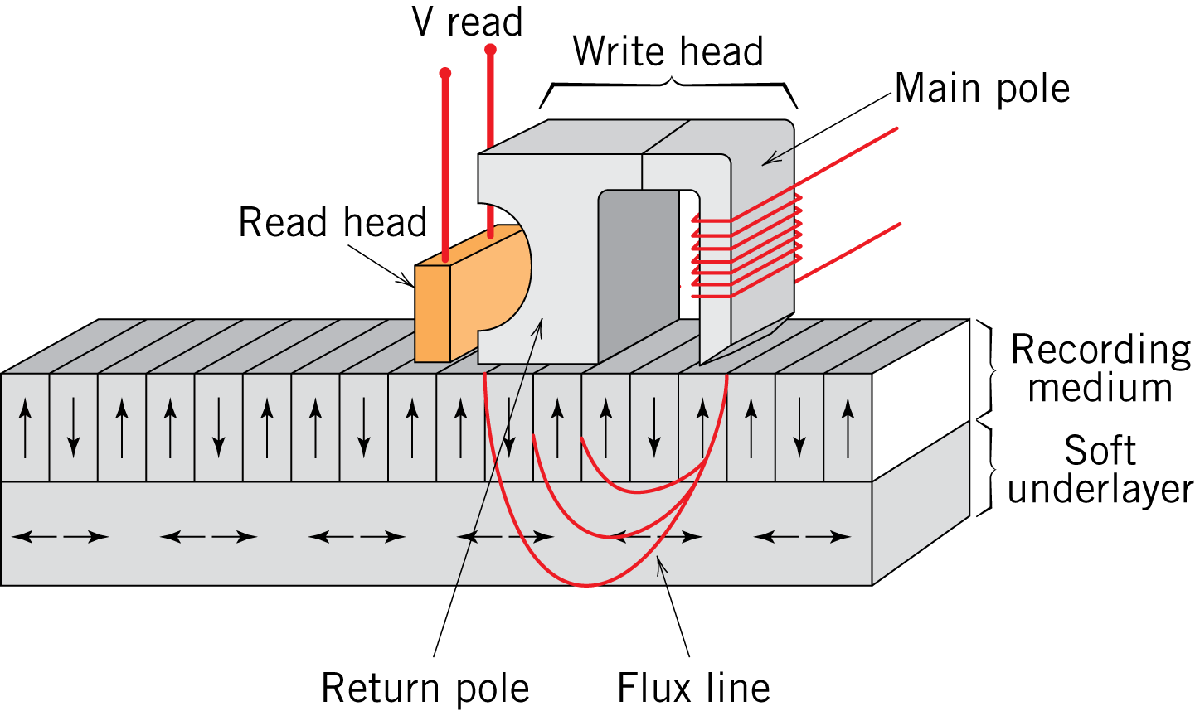
MAGNETIC
Üniversiteye, Memlekete Özgürlük!
• Magnetic Storage:
-- Recording medium
is magnetized by
recording head.
• Magnetic Permeability
vs. Composition:
-- Adding 3 atomic % Si
makes Fe a better
recording medium!
Fe+3%Si
Magnetization
Fe
Magnetic Field
Adapted from C.R. Barrett, W.D. Nix, and
A.S. Tetelman, The Principles of
Engineering Materials, Fig. 1-7(a), p. 9,
Electronically reproduced
by permission of Pearson Education, Inc.,
Upper Saddle River, New Jersey.
Fig. 20.23, Callister & Rethwisch 8e.

Slide 19
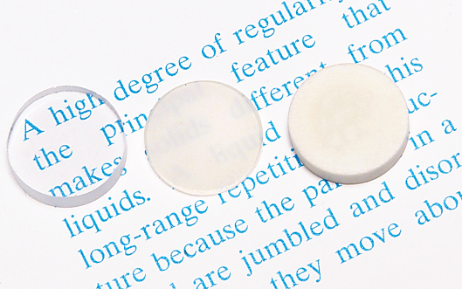
OPTICAL
Üniversiteye, Memlekete Özgürlük!
• Transmittance:
-- Aluminum oxide may be transparent, translucent, or
opaque depending on the material structure.
polycrystal:
low porosity
polycrystal:
high porosity
single crystal
Adapted from Fig. 1.2,
Callister & Rethwisch 8e.
(Specimen preparation,
P.A. Lessing; photo by S. Tanner.)

Slide 20
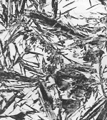
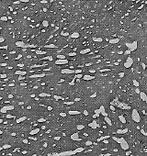
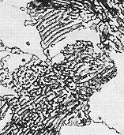
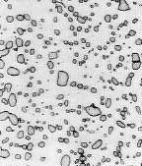
Structure, Processing, & Properties
Üniversiteye, Memlekete Özgürlük!
• Properties depend on structure
ex: hardness vs structure of steel
(d)
6
00
5
00
30 μm
(c)
Data obtained from Figs. 10.30(a)
and 10.32 with 4 wt% C composition,
and from Fig. 11.14 and associated
discussion, Callister & Rethwisch 8e.
Micrographs adapted from (a) Fig.
10.19; (b) Fig. 9.30;(c) Fig. 10.33;
and (d) Fig. 10.21, Callister & Rethwisch 8e.
4
00
(b)
(a)
Hardness (BHN)
3
00
4 μm
2
00
30 μm
30 μm
100
0.01
0.1
1
10
100
1000
Cooling Rate (ºC/s)
• Processing can change structure
ex: structure vs cooling rate of steel

Slide 21
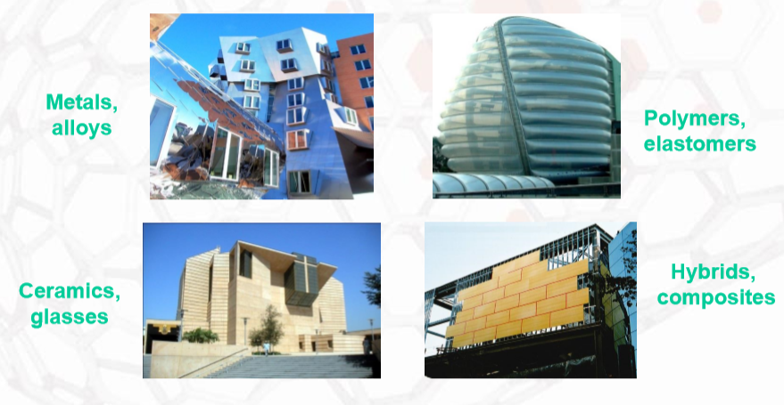
Üniversiteye, Memlekete Özgürlük!
Materials in different fields
Civil Engineering

Slide 22
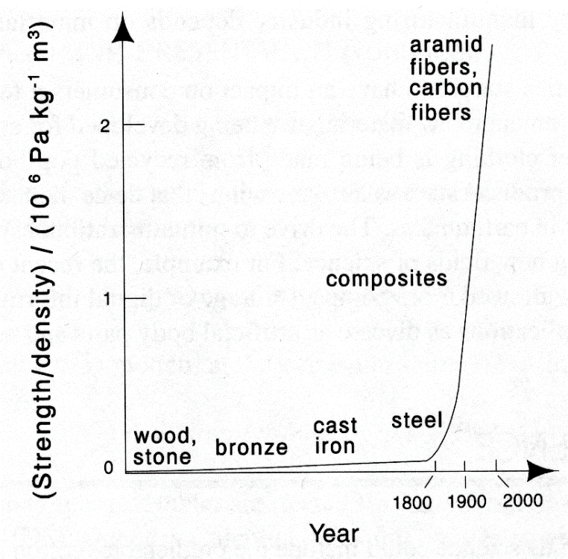
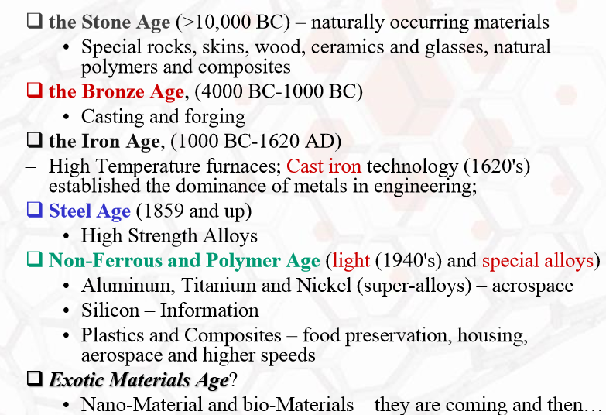
Üniversiteye, Memlekete Özgürlük!
Historical Perspective
Materials drive our society

Slide 23
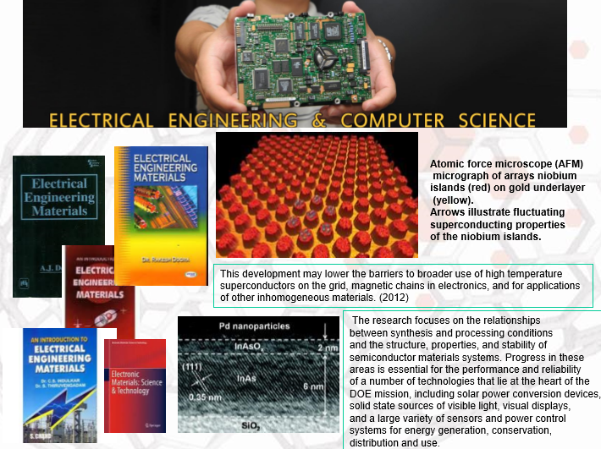
Üniversiteye, Memlekete Özgürlük!
Materials in different fields
Electrical Engineering

Slide 24
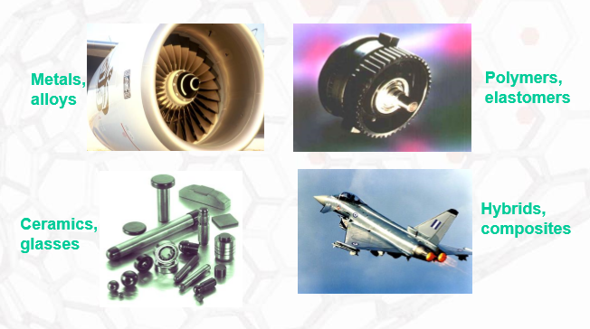
Üniversiteye, Memlekete Özgürlük!
Materials in different fields
Aerospace Engineering

Slide 25
Types of Materials
Üniversiteye, Memlekete Özgürlük!
Metals:
Strong, ductile
High thermal & electrical conductivity
Opaque, reflective.
Polymers/plastics: Covalent bonding → sharing of e’s
Soft, ductile, low strength, low density
Thermal & electrical insulators
Optically translucent or transparent.
Ceramics: ionic bonding (refractory) – compounds of metallic & non-metallic elements (oxides, carbides, nitrides, sulfides)
Brittle, glassy, elastic
Non-conducting (insulators)
Semiconductors, nano materials, bio materials, composites
Notes:
Metals have high thermal & electrical conductivity because valence electrons are free to roam

Slide 26
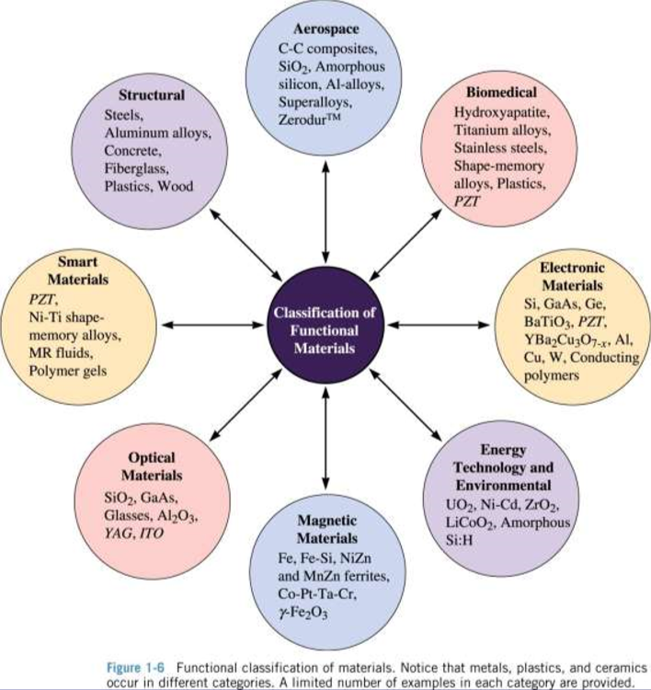
Üniversiteye, Memlekete Özgürlük!

Slide 27
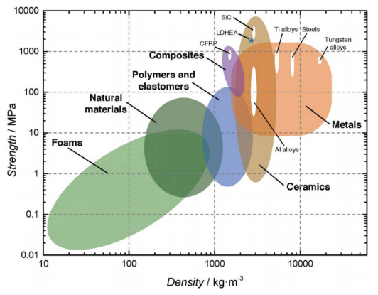
Üniversiteye, Memlekete Özgürlük!

Slide 28
The Materials Selection Process
Üniversiteye, Memlekete Özgürlük!
1.
Pick Application
Determine required Properties
Needs, environment
2.
Properties
Identify candidate Material(s)
Material: structure, composition.
3.
Material
Identify required Processing
Processing: changes structure and overall shape ex: casting, sintering, vapor deposition, doping, forming, joining, annealing.
Cost: Ease of production, access to raw materials, access to production techniques.

Slide 29
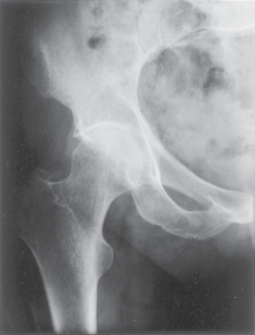
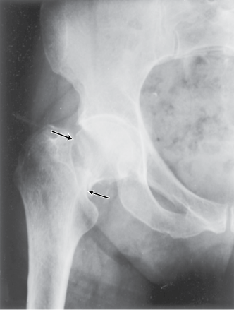
Example – Hip Implant
Üniversiteye, Memlekete Özgürlük!
With age or certain illnesses joints deteriorate. Particularly those with large loads (such as hip).
Adapted from Fig. 22.25, Callister 7e.

Slide 30
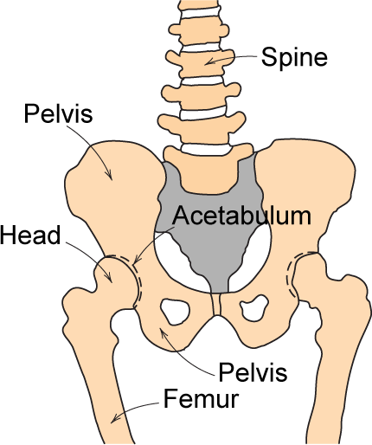
Example – Hip Implant
Üniversiteye, Memlekete Özgürlük!
Requirements
mechanical strength (many cycles)
good lubricity
biocompatibility
Adapted from Fig. 22.24, Callister 7e.

Slide 31
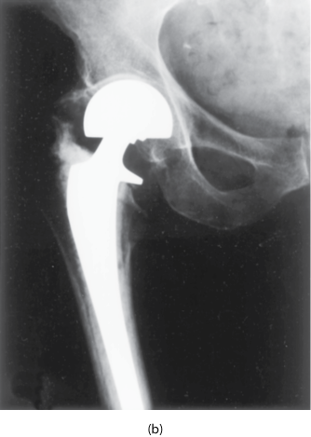
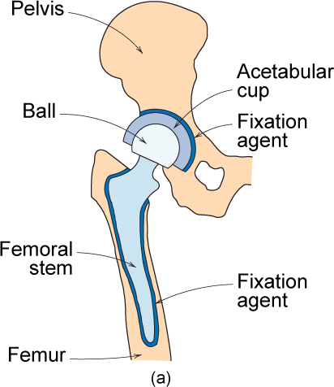
Example – Hip Implant
Üniversiteye, Memlekete Özgürlük!
Adapted from Fig. 22.26, Callister 7e.

Slide 32
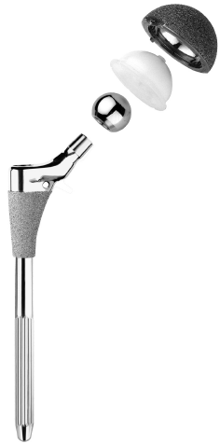
Hip Implant
Üniversiteye, Memlekete Özgürlük!
Key problems to overcome
fixation agent to hold acetabular cup
cup lubrication material
femoral stem – fixing agent (“glue”)
must avoid any debris in cup
Ball
Acetabular
Cup and Liner
Femoral
Stem
Adapted from chapter-opening photograph, Chapter 22, Callister 7e.

Slide 33
Üniversiteye, Memlekete Özgürlük!
Selection examples
Car hood: easy to shape, strong, good transfer, moderately cheap
Space shuttle skin: extremely stable, heat resistant, money is not an issue, low weight
Satellite wings: Extremely good thermal conductivity, low weight, money is not an issue

Slide 34
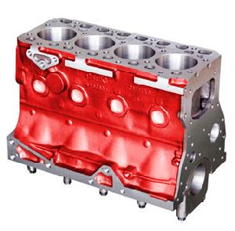
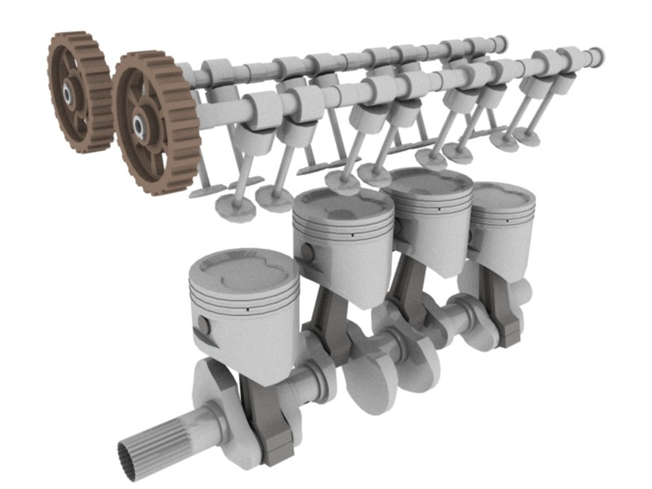
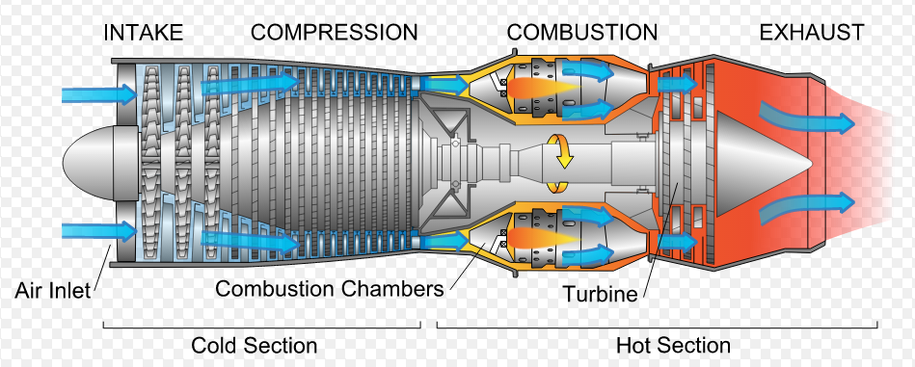
Üniversiteye, Memlekete Özgürlük!
Advanced Materials
Materials used in "High-Tec" applications, usually designed for maximum performance, and normally expensive. Examples are titanium alloys for supersonic airplanes, magnetic alloys for computer disks, special ceramics for the heat shield of the space shuttle, etc.

Slide 35
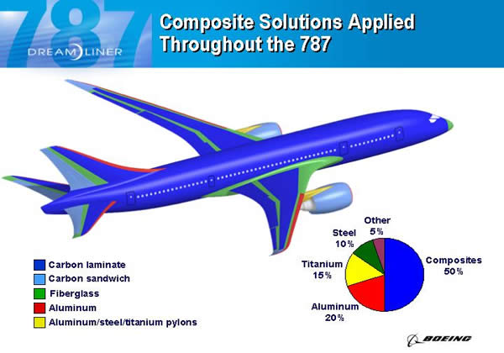
Üniversiteye, Memlekete Özgürlük!

Slide 36
Üniversiteye, Memlekete Özgürlük!
Future of Materials
Design of materials having specific desired characteristics directly from our knowledge of atomic structure.
Miniaturization: “Nanostructured" materials, with microstructure that has length scales between 1 and 100 nanometers with unusual properties. Electronic components, materials for quantum computing.
Smart materials: airplane wings that adjust to the air flow conditions, buildings that stabilize themselves in earthquakes, high tem. materials...
Environment-friendly materials: biodegradable or photodegradable plastics, advances in nuclear waste processing, etc.
Learning from Nature: shells and biological hard tissue can be as strong as the most advanced laboratory-produced ceramics, mollusces produce biocompatible adhesives that we do not know how to reproduce…
Materials for lightweight batteries with high storage densities, for turbine blades that can operate at 2500C, room-temperature superconductors? chemical sensors (artificial nose) of extremely high sensitivity, cotton shirts that never require ironing

Slide 37
SUMMARY
Üniversiteye, Memlekete Özgürlük!
Course Goals:
• Use the right material for the job.
• Understand the relation between properties,
structure, and processing.
• Recognize new design opportunities offered
by materials selection.

